Slide 1
GRANT WRITING for
ArtSeed
Racine Arts Council
Original presentation by Debra Karp,
University of Wisconsin – Parkside
March 1, 2021
1

Slide 2
Objective
● Participants will understand good practices in proposal preparation and leave with tips that will help them become more successful in securing ArtSeed grant funding.
2

Slide 3


What Grant Writing is Not
● An easy source of income
● A quick fix
● A big mystery
4

Slide 4

What Grant Writing is
● An excellent tool for planning a
program/project
● One strategy to add to the
contributed income mix for a
successful nonprofit
5

Slide 5
The Fundamentals of ArtSeed
https://www.racineartscouncil.org/artseed-grant-program

Slide 6
General Grant Writing Topics
 Planning and Preparing the Proposal
    Writing Goals, Objectives, Activities and Outcomes
    Elements of the Proposal
    Budget Development
 Submission
 Review
6

Slide 7
Planning
1. Assemble a grant development team
- Figure out who you need to include within your organization
- Figure out who you need to include as partners outside your organization
2. Devise a timeline for proposal development
- It may be useful to put together a chart with tasks, who is assigned to each task, and due dates for each task
Convene team and any project partners for planning sessions
► Discuss roles in grant development - Be clear about what you need from everyone, especially commitment from outside
► Contributions to the project (time and money) - Discuss partners’ ability to contribute time and money to the project. Partner time is a good way to come up with In Kind match for the grant
► Plan for letters of support - Include letters of support ON LETTER HEAD, from all partners. Best to ask for these early and offer to write up a draft outlining what you need.
12

Slide 8
Elements of the Proposal
13

Slide 9
Project Information
Project Description (500 words)
  Include collaborators and roles
  Be specific
14

Slide 10
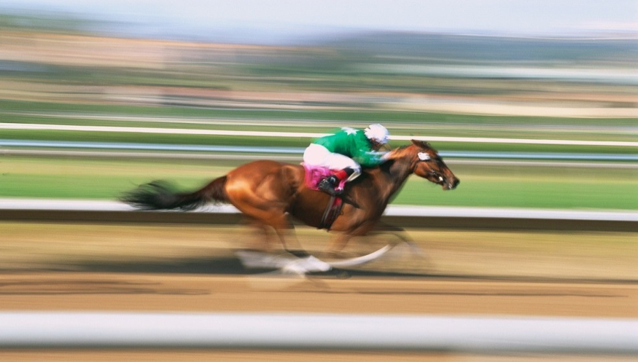
Project Goals and Objectives
Goals, Objectives and Outcomes
►Goals—broad, lofty statements (the change you wish to make)
►Objectives—specific, measurable, attainable, realistic, set in a timeframe (SMART) (specific and measurable statements of how you will reach goals
SMART goals are Specific, Measurable, Achievable, Relevant, and Time-bound.
SMART goals are clear, attainable and meaningful.

Slide 11
Project Outcomes/Impact
What will be different as result of your project? How will you know?
15

Slide 12
Exercise:
Goals/Objectives
Development
18

Slide 13
Goal | Objectives | Activities | Outcomes/ Impact | Related Budget Items
Broad, general, intangible, and abstract. You will probably not have more than a few goals. | Specific, measurable and set in a time frame | Specific, with dates and person responsible | Results or changes | It is helpful to link your activities to a budget item. This will help you avoid omitting a budget item and it helps with project development.
 | Most applications include at least 3-5 objectives | Typically, you will have several activities that are designed to meet the objective. | Most applications should also have several outcomes that relate to the objectives and related activities. | Many budget items will cross cover several activities, such as personnel, travel, supplies, and equipment.
19

Slide 14
Target Audience & Expected Reach
Figure out ahead of time what you want to accomplish and how you will know if you have accomplished this. This will make tracking your results much easier and make your proposal stronger.
Can’t be all things to all people
Identify demographics
Anticipated numbers
- Develop a procedure up front for what data will be collected, how and when, by who, and how you analyze that data.
- Product of a program’s activities - should be a # or %
- Very specific items of information that track a program’s success or on outcomes
- What do you want to measure?
- Develop a procedure up front for what data will be collected, how and when, by who, and how you analyze that data.
Is this a new audience? Is it underrepresented?
21

Slide 15
Target Audience & Expected Reach
Example: Food Bank
Outcome (The change in or benefits for a participants during or after their involvement in program activities): Participants will have improved access to food
Activities (What a program does): Provide Food to qualified families
Outputs: 50 families will be served every month, each family will have access to 1 fresh vegetable
Indicators: Enough food to eat each month, access to all food groups
What do you want to measure? How and when data will be collected
Ex: Using surveys, participants report having enough to eat,
Program will track amount of fresh vegetables distributed to each family
21

Slide 16
Project Promotional Plans
Press Release
Social Media
Posters / Banners / Signs / Flags
Cross-promotions
Programs
Others?
22

Slide 17
Have You Applied Before?
How will the proposed project grow and deepen the impact? What is new?
Figure out ahead of time what you want to accomplish and how you will know if you have accomplished this. This will make tracking your results much easier and make your proposal stronger.
Most funders do not fund recurring or multi-year grants (or rarely).
Is this a short-term project with an end date? If so, how will this short-term project have an impact?
How you will continue this project after funding is done:
New/additional funding-Plan ahead
Reduction of program
What funding will you secure to sustain program?
21

Slide 18
Budget and Budget Description
►RFP will describe allowable costs
►For ArtSeed: Be sure requested budget amount is within
$500-$1,500 range
►Understand and show how you will meet the
match requirements—in-kind or cash
23

Slide 19
 Personnel
 Consultants and contracts (Outside Fees and Services)
 Travel
 Space Rental
 Materials and Supplies
 Match: cash, in-kind
Budget Line Items

Slide 20

Submission
Review, Package, and Send
►Deadlines are not negotiable—plan accordingly
►Review outline to be sure nothing is missing
REVIEW:
Proof read
Ask someone who is not working on project to review for errors or parts that are unclear.
If written by more then one person, review sections for consistency. For example, if you spell out the full name of your organization, make sure that it is not referred to as an acronym elsewhere in the proposal.
Try reading from end to front - easier to catch errors
Review RFP again to make sure you have included everything.
30

Slide 21
* Following application guidelines/requirements
 Fit with funder’s guidelines/funding priorities
 How important or compelling the need/problem is
 Impact on those served
 Program planning and feasibility
 Organization/leadership capacity
 Quality of the proposal
 Endorsements/letters of support/commitment
 Other support/funding/resources
What Reviewers Look for
31

Slide 22
What to Do When Funded
►Complete all contracts for award before beginning to expend funds
►Thank funder
►Thank those partners who helped
►Keep in touch with funder
1.) Share media coverage and articles
2.) Invitations to Events
3.) Fulfill all Required Reporting in full and on time
Review reporting requirements and dates.
Don’t miss reports.
Looks bad.
Can jeopardize future funding.
32

Slide 23
What to Do if You are
Not Funded
►Find out why
►If you feel it’s a good fit, try again!
33

Slide 24

Tips for Writing a Great Grant Proposal
►Review the proposal early and often. Don’t use a shotgun approach—tailor the proposal to the RFP.
►Have staff and grant writing team members review the proposal for consistency and correctness.
     Ask a 3rd party to review as well.
►Use a positive writing style—emotional appeal but back up with facts.
Source: Intermediary Development Series: Acquiring Public Grants, Dare Mighty Things, Inc., Compassion Capital Fund, US Department Health & Human Services

Slide 25
Tips for Writing a Great Grant Proposal
(Cont’d)
►Organize proposal to match order in RFP and follow guidelines for font size, margins, etc.
►Eliminate jargon and use active voice.
►Review the writing style and make sure it is consistent. The proposal should “flow” and be easy to read.
►Make the proposal visually attractive, but don’t overdo.
   Bulleting, tables/graphs, spacing, bold/italics/caps
Source: Intermediary Development Series: Acquiring Public Grants, Dare Mighty Things, Inc., Compassion Capital Fund, US Department Health & Human Services

